Slide 1

CS 779 Term Project FALL 2020
By Christopher Pellegrino

Slide 2

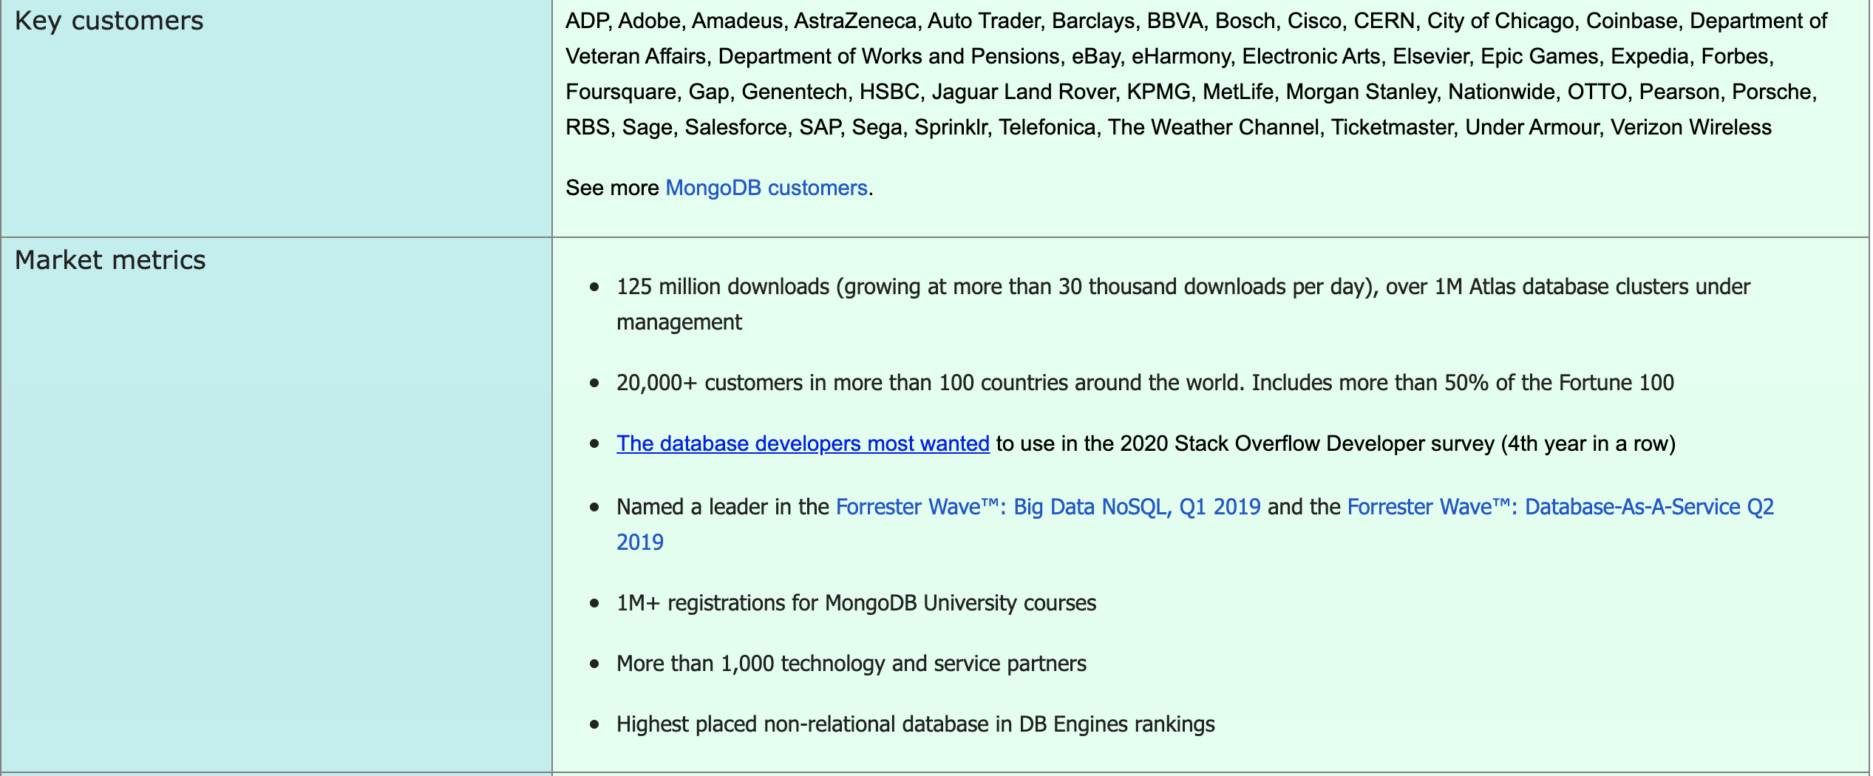
Area of Focus: NoSQL, specifically MongoDB
Notes:
For my term project I decided I wanted to research NoSQL databases, and in my case I chose MongoDB. I picked MongoDB as my specific NoSQL database because of it’s rising popularity in the tech industry and in many other industries as well. They have major corporate and governmental customers and a positive trajectory in the amount of market share they’re taking up for database usage in general. MongoDB is the top used NoSQL database system.
Learning about MongoDB has real world value to many employers, some of which I would like to point out are eBay (e-commerce), Salesforce (customer relation management service for marketing), Cisco (networking hardware and software), Verizon (telecommunications), the U.S. Department of Veteran Affairs (federal cabinet-level agency in the US government), and Adobe (multimedia and creativity software).

Slide 3
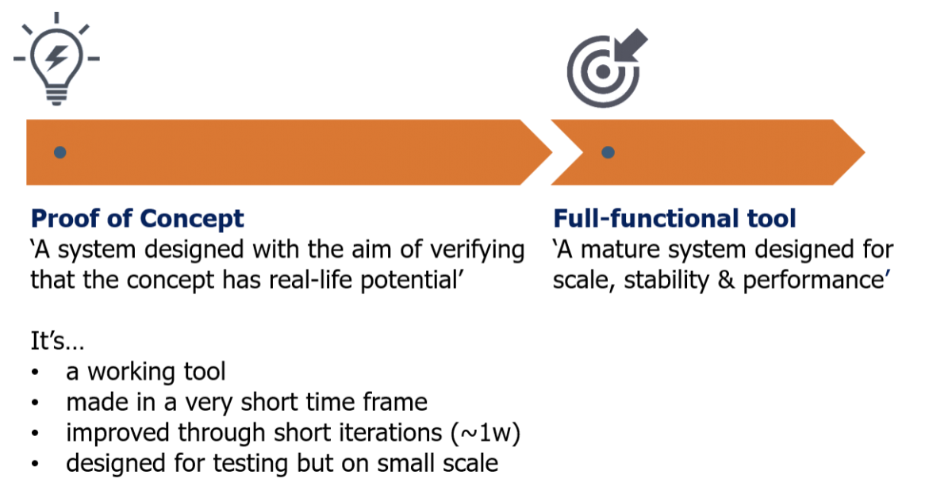
Proof of Concept
Notes:
Proof of concept for this project is to verify the feasibility of using MongoDB to perform data analysis on datasets that do not share the same schema, thus conveying the NoSQL database’s flexibility. This will be done using comma separated value (CSV) files named songs_data.csv and train_triplets.txt.
General queries, aggregate functions (e.g. sum, average, count, etc.), and transforming the train_triplets.txt file to a CSV file so that its data can be stored in the Google Cloud. If I had had more time I would’ve learned more about Google’s data warehouse Google Cloud (not the same as Google Drive).

Slide 4
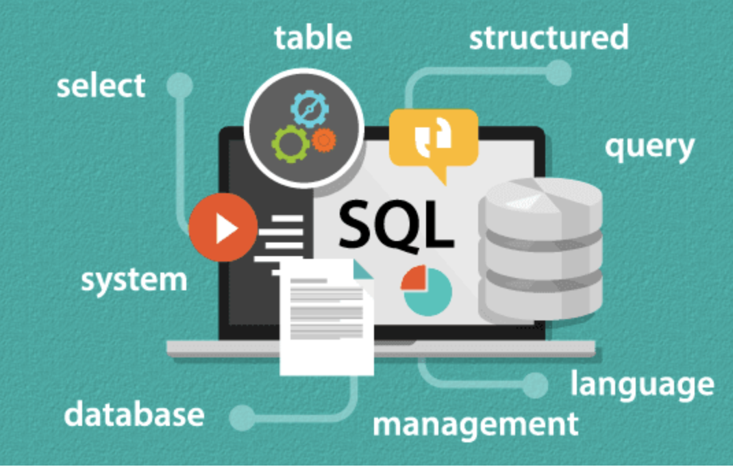
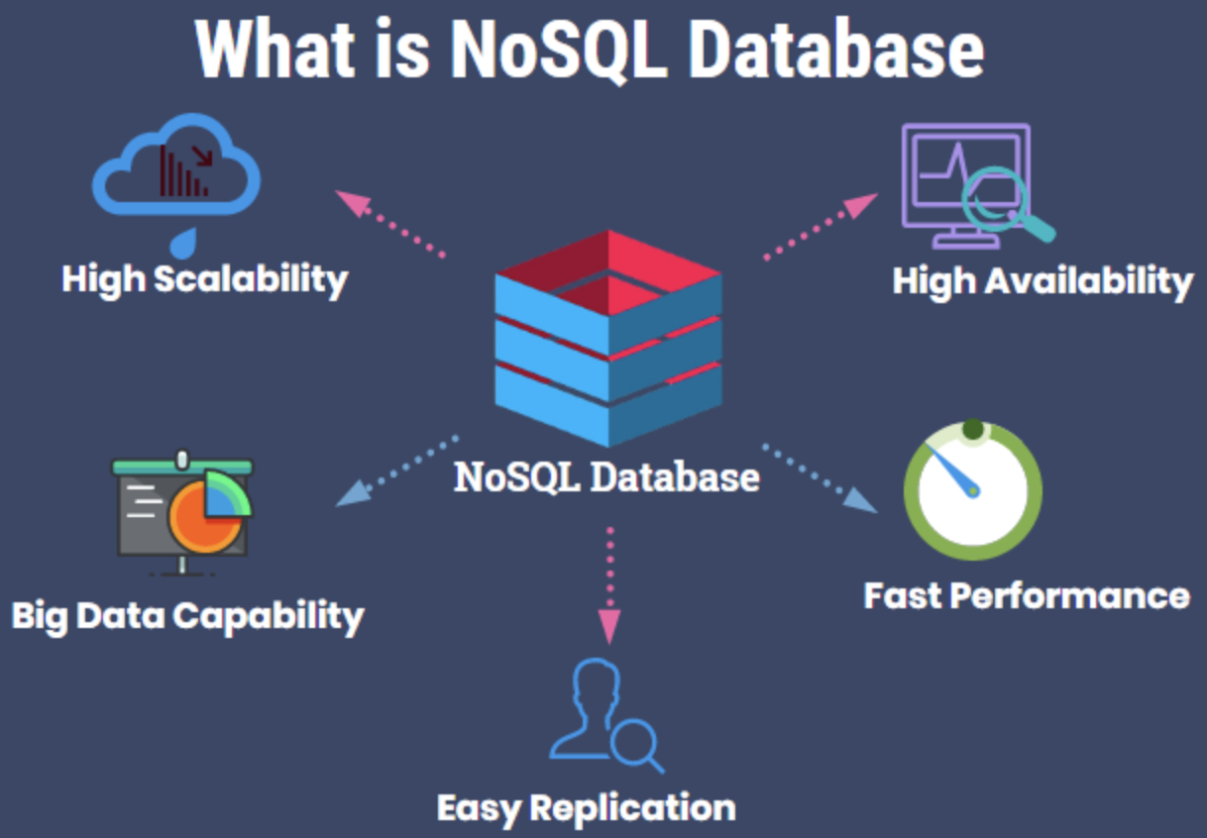
SQL vs. NoSQL: The Difference
Notes:
Relational databases are designed and managed using Structured Query Language (SQL). The type of data it is best used for is data that is structured, such that relationships between tables can be easily established.
NoSQL databases can vary as to what language they use, and some can even use SQL. They are often used for big data and real-time web applications. They are better for working with semi-structured and unstructured data.

Slide 5
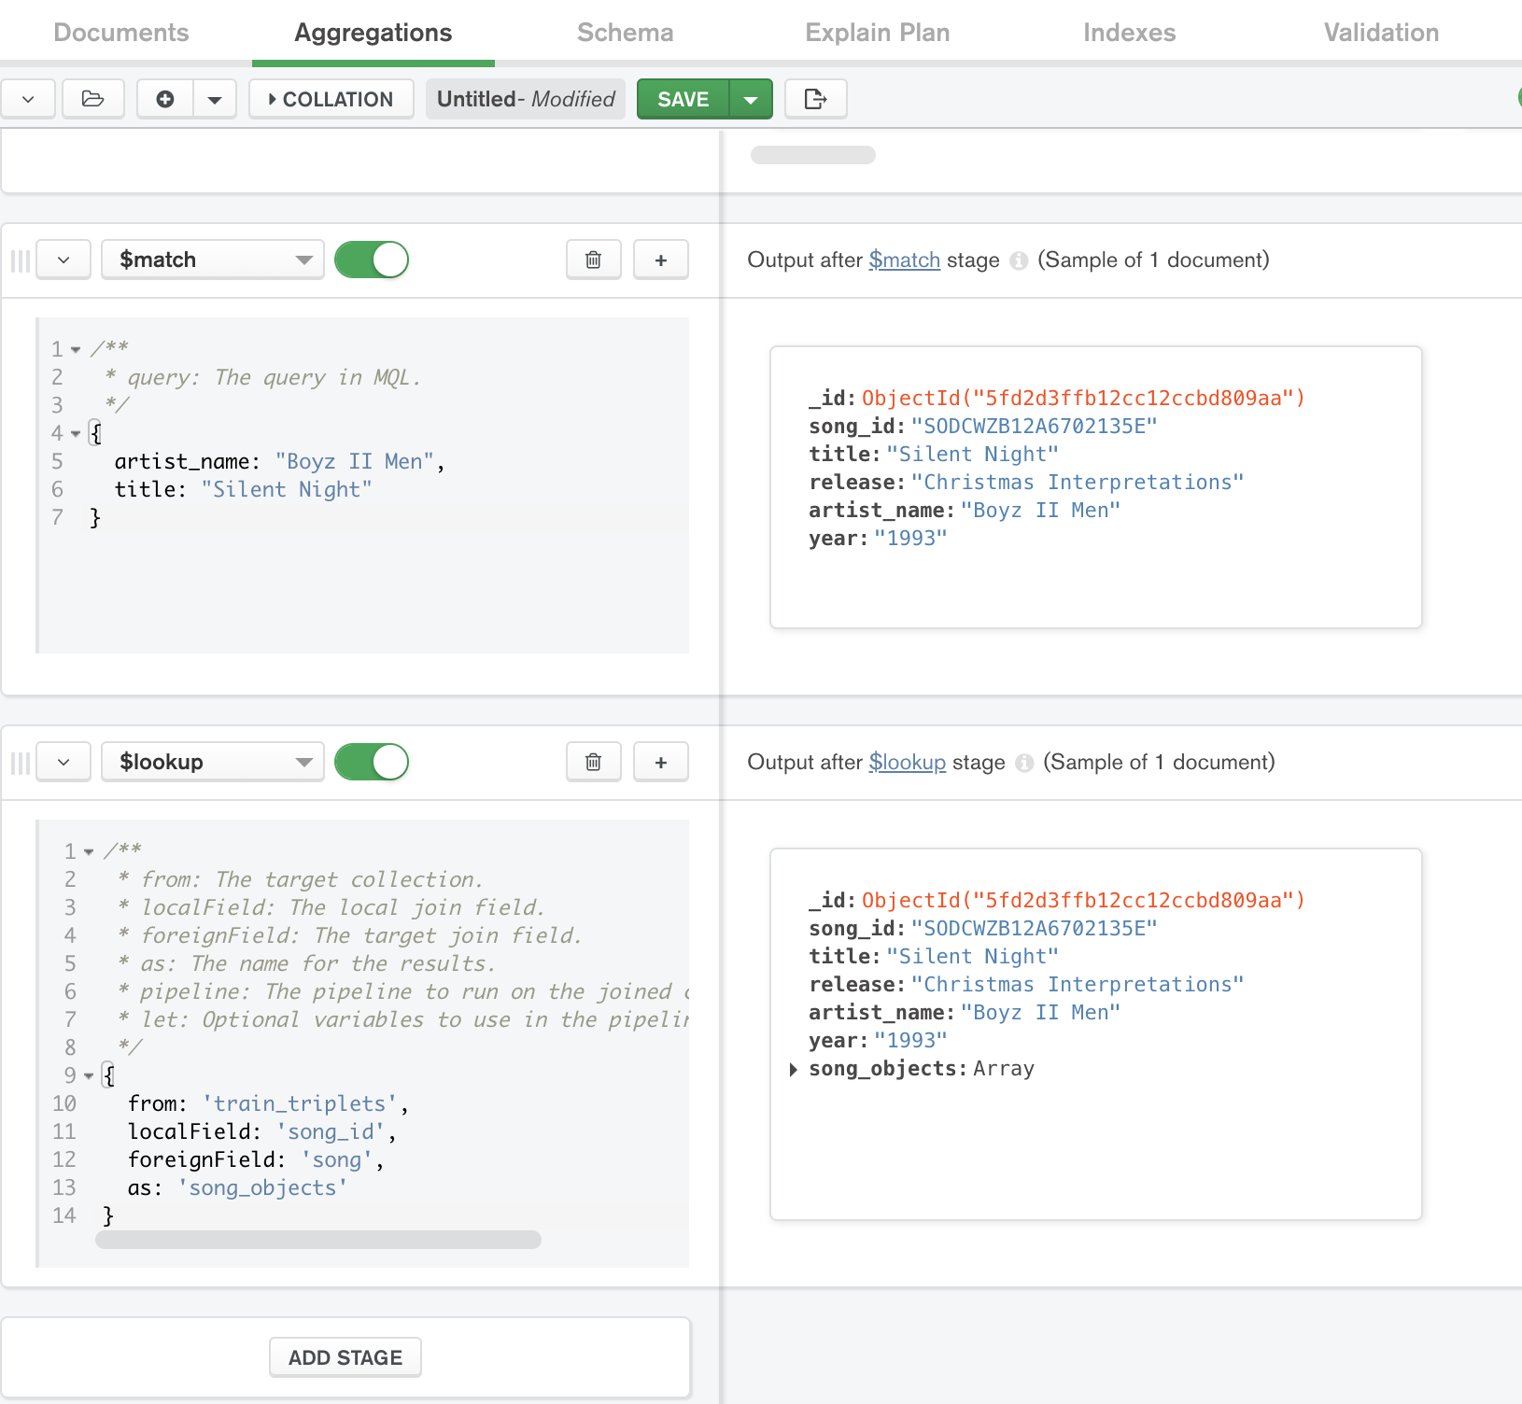
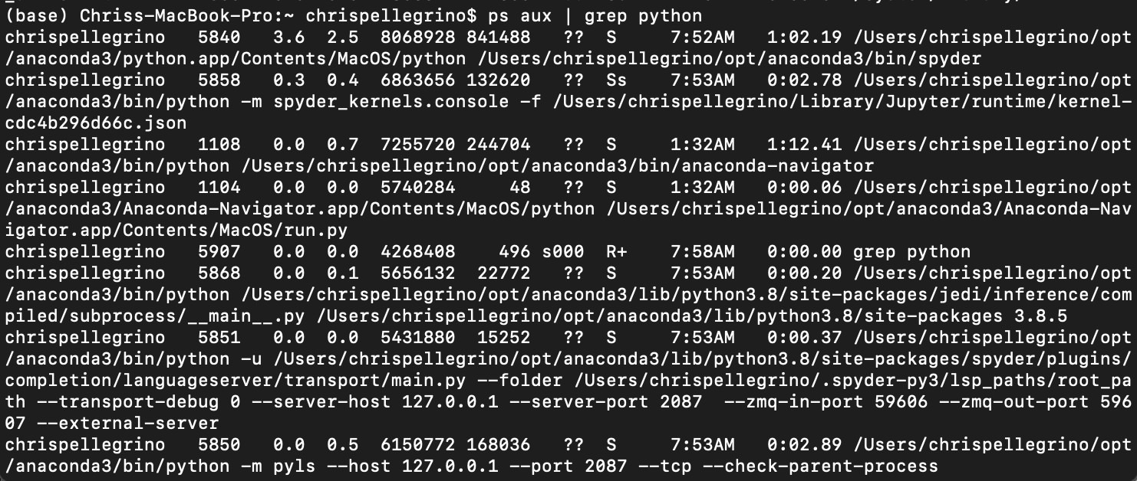
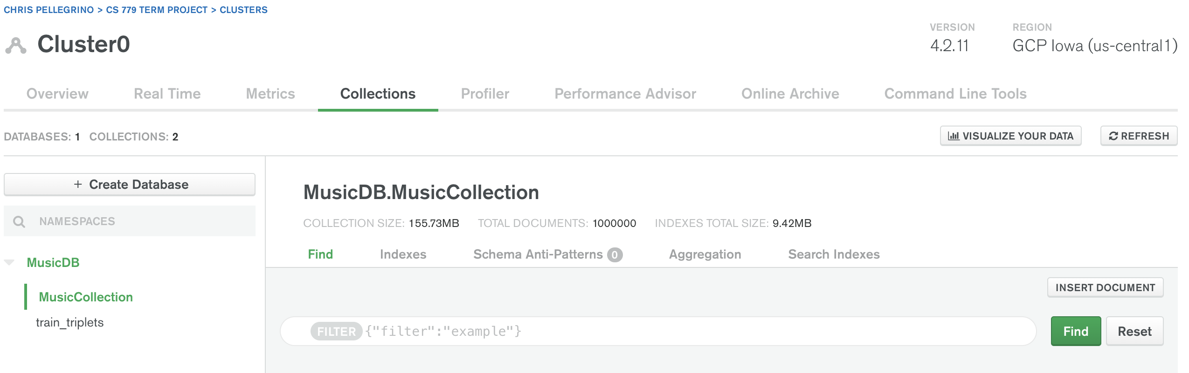
Planned Goals for Learning
Notes:
My learning goals for this term project are to learn how to use MongoDB via Mongo Atlas and Mongo Compass.
I also planned to learn how to write some BASH script for Terminal (Mac OS command line) which uses UNIX.

Slide 6
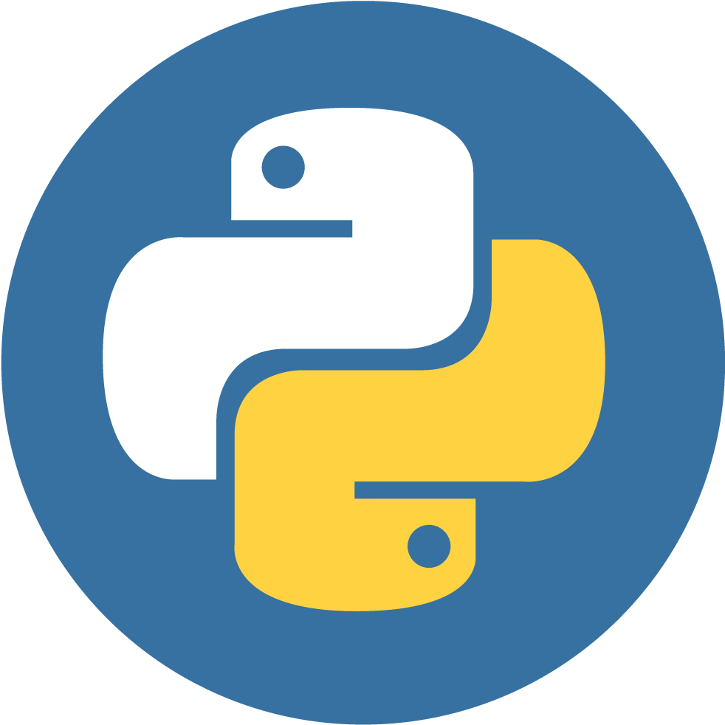


Skills From Other Courses & New Element Related to Advanced DB Management
Notes:
Since MongoDB provides support for Python, my preferred programming language, I will be using my knowledge from CIT-12:5 Introduction to Python Programming (taken at Bunker Hill Community College) and MET CS 521: Information Structures with Python. I will be building on this skill by using the PyMongo distrubtion with Mongo Atlas.
In terms of environment, in CS 521 I used Anaconda distribution for Python that has an application called Spyder, which will be my Integrated Development Environment (IDE) for this assignment.

Slide 7


Challenges: Installation & Setup
Install Xcode
Install Homebrew
Needed to configuration to a file called .zshrc to include executable path of the Homebrew command to install MongoDB tools to use Mongo Import to import CSV

Slide 8
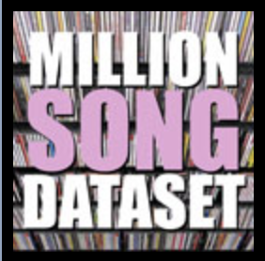
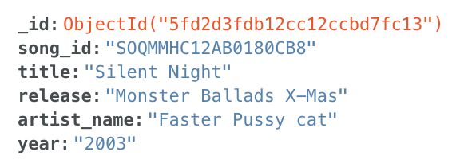
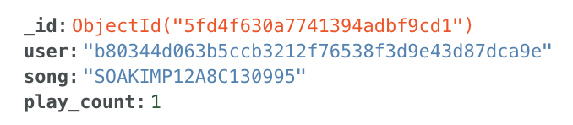
Data Being Used
import pymongo
from pymongo import MongoClient
import json
import csv
import pandas as pd
import os
import dns
import pprint
#programatically convert train_triplets.text to csv file, which I then imported into Mongo Atlas using Mongo Compass
read_file = pd.read_csv (r'/Users/chrispellegrino/Desktop/train_triplets.txt', delimiter = "\t", names = ['user', 'song', 'play_count']) #use pandas to read txt
read_file.to_csv (r'/Users/chrispellegrino/Desktop/train_triplets.csv', index = None) #converting to csv
csv_file = pd.read_csv (r'/Users/chrispellegrino/Desktop/train_triplets.csv')
print(csv_file.head())
A record from song_data.csv
A record from train_triplets.csv
Notes:
My first dataset is the Million Songs Dataset Subset originally published by Echo Nest. The dataset is 10,000 songs. A description of each track is provided, which is the unstructured data. The data comes with a .txt and a .csv format, which is different from my original intention of a JSON format file. MongoDB converts CSV files into JSON though. The website’s subset link did not work for me so I downloaded a copy from a Kaggle account that previously used it.
In the interest of time I decided not to use the actual million song dataset because the entire dataset is 280GB.
My second dataset is the Taste Profile dataset published by The Echo Nest, which is a music intelligence and data platform for developers and media companies that has been owned by Spotify since 2014. It came in a .txt file that was over 3GB. Free txt to csv converters would not let me convert it as it was too big. So I converted it to a csv programmatically in Spyder using Python. Importing the train_triplets.csv file into MongoDB took over an hour.

Slide 9
What Data Structures To Make?
What Is MongoDB?. (n.d.). https://www.educba.com/what-is-mongodb/
Notes:
I was originally considering doing an embedded structure in which I would’ve stored my two collections together to have one collection. But I wanted to show the flexibility of MongoDB, which is that it can store different collections that have different schemas.

Slide 10
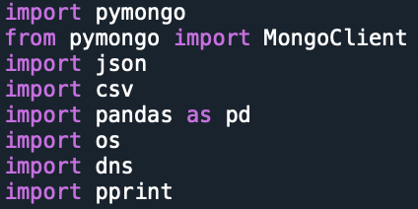
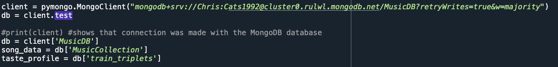
Running Code

Slide 11
Challenges & Overcoming them
Notes:
There were a significant amount of challenges when building and attempting to do this project.
Simply finding out that I needed XCode to download Homebrew to download MongoDB Tools to use them with PyMongo (which also needed to be installed).
One was I wanted to use mapReduce on the data, however after seeing that it is not available on the free version of MongoDB, this was no longer an option.
Later on when I tried it in PyMongo I realized my datasets (specifically the train_triplets one from taste_profile) would cause the execution to time out.
I underestimated how long it would take to import data. The second dataset, train_triplets from Taste Profile, took well over an hour to import 3GB of data.

Slide 12
Real World Applications
Notes:
The real world applications for MongoDB/NoSQL in general is that they offer more flexibility to developers using non-structured data. MongoDB works well with PyMongo to help with querying data and data analysis. Once databases become so large (e.g. millions of users on Amazon), having a relational database can be difficult to maintain.
An example would be Shutterfly, an internet-based photo sharing and publishing site that has over 6 billion images. Having a non-relational database improved their programmers’ productivity, performance and scalability of their database to suit their large data set

Slide 13
References
Anaconda Python Logo Clip Art. (n.d.). https://www.pinclipart.com/pindetail/oJhbJi_anaconda-python-logo-clipart/
Bandyliuk. (2020, June 22). New Xcode Icon. Reddit. https://www.reddit.com/r/swift/comments/hdy1wq/new_xcode_icon/
Banerjee, A. (2018, February 22). Million Song Data Set Subset. Kaggle. https://www.kaggle.com/anuragbanerjee/million-song-data-set-subset
Brody, A. (2017, March 9). SQL Vs NoSQL: The Differences Explained. panoply blog. https://blog.panoply.io/sql-or-nosql-that-is-the-question#:~:text=Reasons%20to%20Use%20a%20NoSQL,1
Data Science Proof of Concept. (n.d.). https://www.element61.be/en/competence/data-science-proof-concept
Francis, A. (2019, June 21). Top 5 Challenges in Providing Managed Security. Channel Futures. https://www.channelfutures.com/mssp-insider/top-5-challenges-in-providing-managed-security
Gopinath, S. (2019, May 22). Real World Use Cases of MongoDB. Edureka!. https://www.edureka.co/blog/real-world-use-cases-of-mongodb/
Hemphill, K. (2020, April 17). How to use Terminal on Mac. Macworld. https://www.macworld.co.uk/how-to/how-use-terminal-on-mac-3608274/
Maddow, R. (2016). Mongodb Logo Png, Transparent Png. vhv.rs. https://www.vhv.rs/viewpic/mmRJbm_mongodb-logo-png-transparent-png/
N.A. (2020). MongoDB System Properties. DB-Engines. https://db-engines.com/en/system/MongoDB
The Missing Package Manager for macOS (or Linux) – Homebrew. (n.d.). https://brew.sh/
MongoDB NoSQL Document-oriented database, nosql icon, leaf, grass, business png. pngwing. (n.d.). https://www.pngwing.com/en/free-png-deuul/download
Python Logo Clipart Transparent Background - Png Download. (n.d.). https://www.pinclipart.com/pindetail/wxihmx_python-logo-clipart-transparent-background-png-download/
Python Logo Png -spyder Logo - Spyder Python Icon, Transparent Png. (n.d.). https://www.vhv.rs/viewpic/iTiiJow_python-logo-png-spyder-logo-spyder-python-icon/
Singaram M. and Prathistha J. What is the Difference between Proof of Concept and Prototype?. Entrepreneur India. https://www.entrepreneur.com/article/307454

Slide 14
References
Thierry, B. et al., (2011, February 8). The Million Song Dataset. http://millionsongdataset.com/pages/getting-dataset/#subset
Thierry, B. et al., (2011 , February 8). The Million Song Dataset. http://millionsongdataset.com/pages/example-track-description/
Virga, F. (2019, February 1). Deploy and Secure MongoDB on Atlas. Gitconnected. https://levelup.gitconnected.com/part-2-deploy-and-secure-mongodb-on-atlas-4820d539a1dc
What Is MongoDB?. (n.d.). https://www.educba.com/what-is-mongodb/
White, L. (2019, December 5). SQL Vs NoSQL - Which Is Best For You?. Codesera. https://codersera.com/blog/sql-vs-nosql-comparision/
29 common beginner errors on one page. (n.d.). https://pythonforbiologists.com/29-common-beginner-errors-on-one-page

